Slide 1

Remotely Controlled Bending Machine
Kickoff meeting

Slide 2
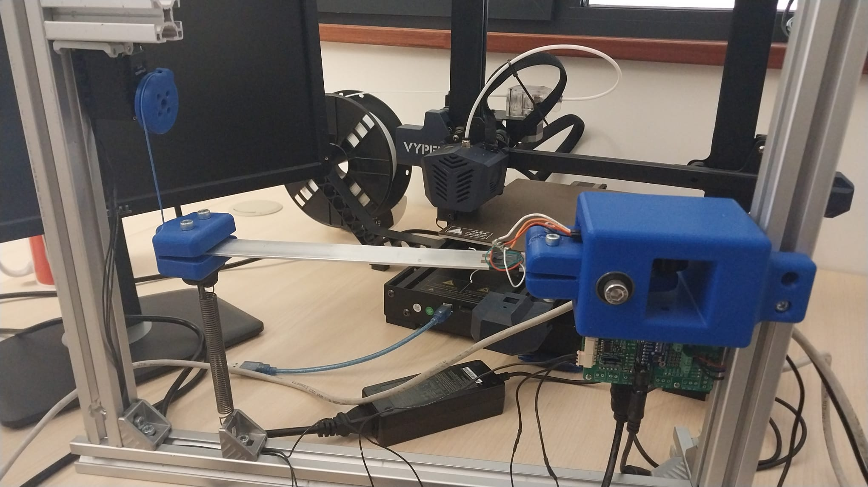

Slide 3
Kickoff
If the end date still stands, and if not why, and what is the new expected end date
The issues you encountered
The tasks you were able to complete
The deliverables you already handed over
The risks evolution (some can be more or less likely to happen, some may be obsolete, some new ones could appear)
The next big tasks to come
If you have a product (or prototype, or piece of something) to show us, please do so
Any other point you deem relevant for this meeting

Slide 4
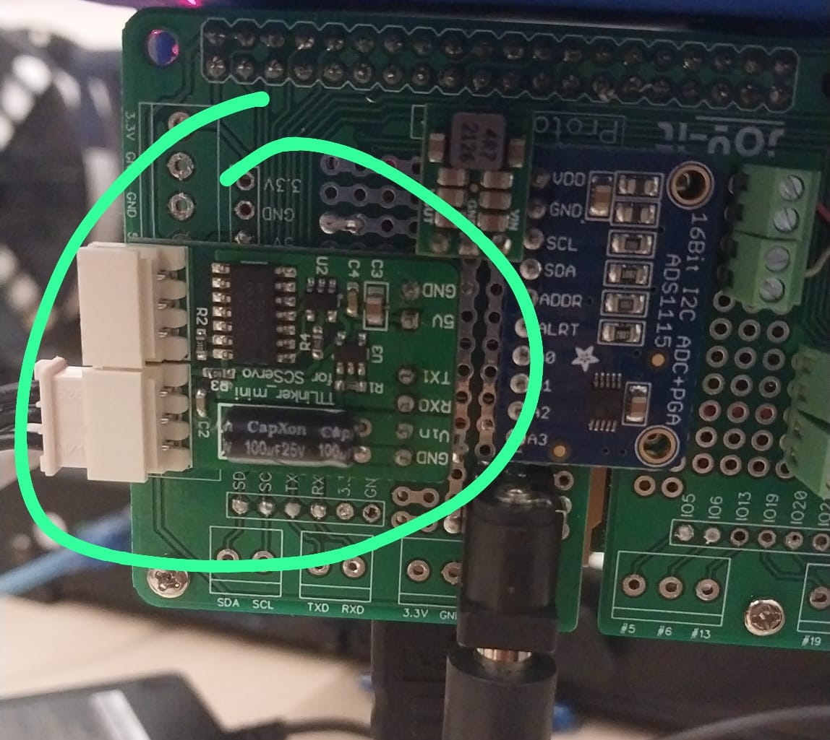
Issues encountered
The machine doesn’t work

Slide 5
Completed tasks
import RPi.GPIO as GPIO
import time
# GPIO pin numbers for your sensors and encoder
strain_sensor_pins = [17, 18, 27]
encoder_pin = 23
def setup_gpio():
GPIO.setmode(GPIO.BCM)
# Set GPIO pins as inputs
for pin in strain_sensor_pins:
GPIO.setup(pin, GPIO.IN)
GPIO.setup(encoder_pin, GPIO.IN)
def read_strain_sensors():
sensor_data = []
for pin in strain_sensor_pins:
sensor_data.append(GPIO.input(pin))
return sensor_data
def read_encoder():
return GPIO.input(encoder_pin)
if __name__ == "__main__":
try:
setup_gpio()
while True:
strain_data = read_strain_sensors()
encoder_data = read_encoder()
print(f"Strain Sensors: {strain_data}")
print(f"Encoder: {encoder_data}")
time.sleep(1) # Read data every second
except KeyboardInterrupt:
print("Exiting...")
finally:
GPIO.cleanup() # Cleanup GPIO pins on program exit
Sensors testing

Slide 6
Risks
Risk | Probability | Danger | Fixable
No motor | 20 | 100 | Yes
Raspberry breaks | 15 | 100 | Yes
No camera | 20 | 30 | Yes
Communication issues | 60 | 60 | ?
Outdated libraries | 10 | 60 | ?
Broken sensors | 25 | 10 | Yes
Image processing | 30 | 5 | Yes
Machine breaks again | 5 | 100 | No

Slide 7
Next tasks
Fixing the machine
Remote communication (Rest-API) on the Raspberry Pi
Image management
Remote UI

